Slide 1
BeatSabers
Dev Team:
Hung Do
Carmen Cheung
Ani Mohan
TaylorMarquez
Saengduean (Em) Calderez
Justice Chase
Tatem Hedgepeth
Audio Team:
Sean Thompson
Jairus Cambe
Jake Little
James Jordan

Slide 2
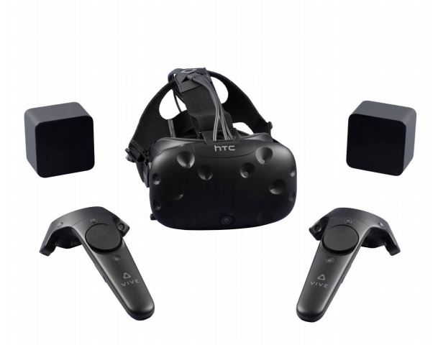
Executive Summary
BeatSabers is an action oriented rhythm-based game played using Virtual Reality (VR) headsets that includes movement of the player’s whole body.
We teamed up with University of California San Francisco’s (UCSF) Neuroscape department, to help improve brain function through this game.
Notes:
Hung

Slide 3
UCSF Specifics
Neuroscape is a neuroscience center at UCSF which combines technology with scientific research to better improve brain function for all.
Their hypothesis is that rhythms will make the player better at anticipating, which links to cognitive improvements.
With the combination of both physical aspect and cognitive training in virtual reality experience, the results would yield better improvements than just cognitive training alone.
Notes:
Hung

Slide 4
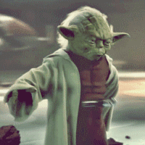
And we have Lightsabers!

Slide 5
Game Concept
Notes:
Hung

Slide 6
Two lightsabers that to slice appropriate shiny orbs
VR stage
We have some robots for obstacles
Exercise heavy to improve health
Fun and replayable

Slide 7
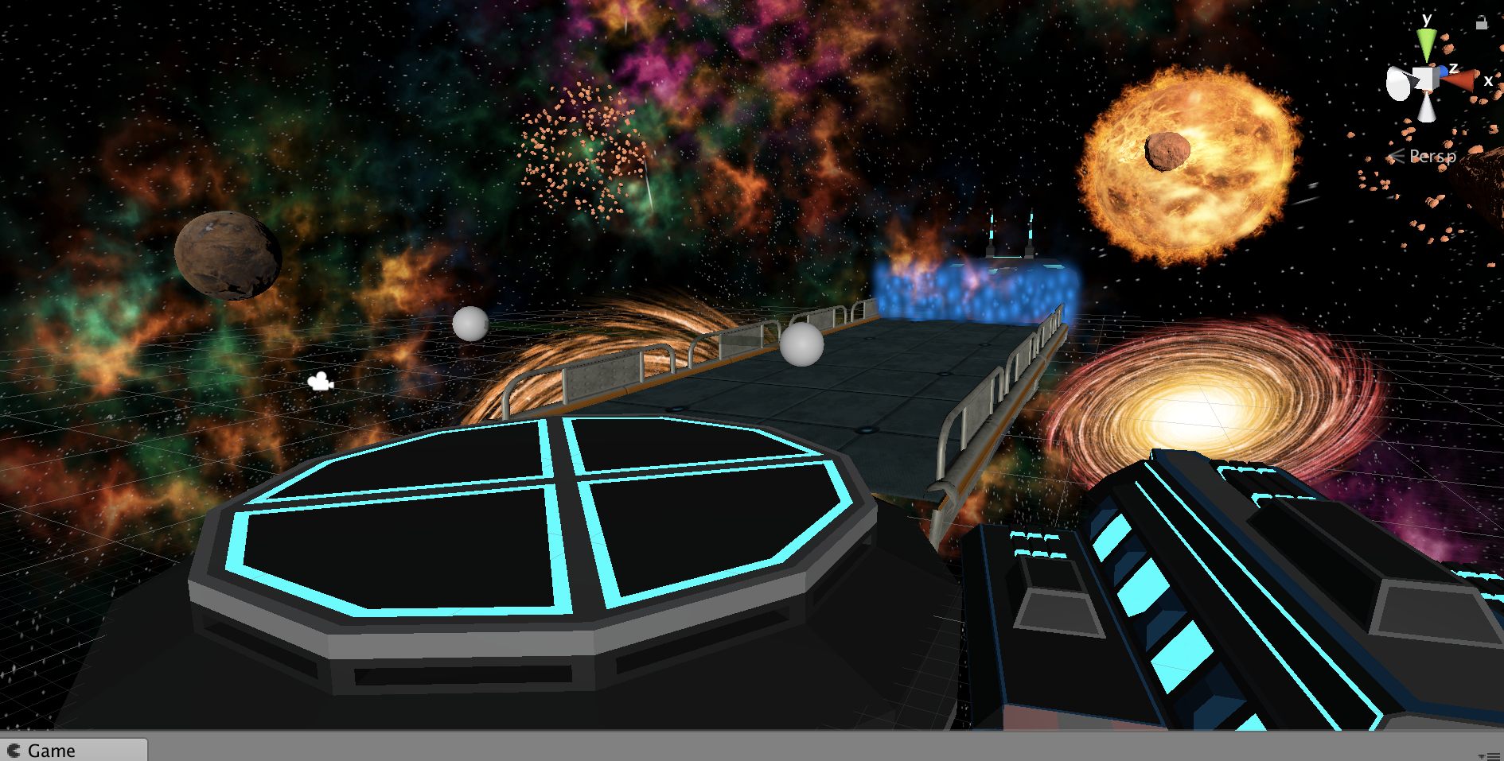
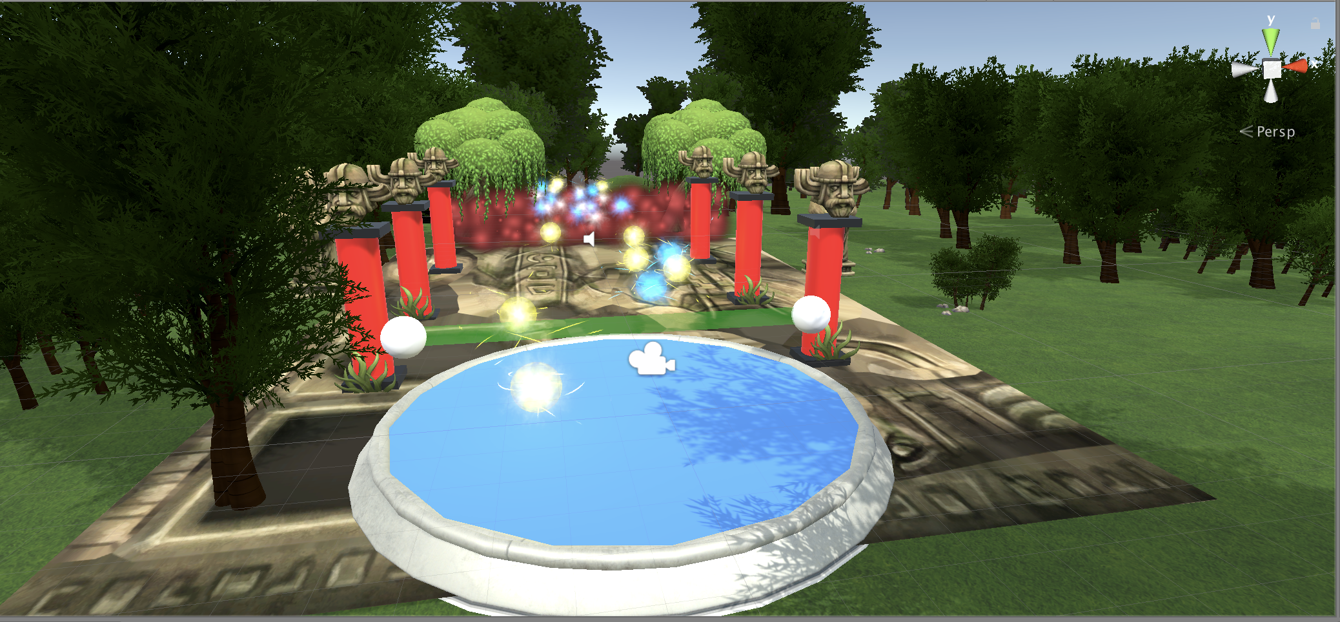
Stages
Notes:
Ani

Slide 8
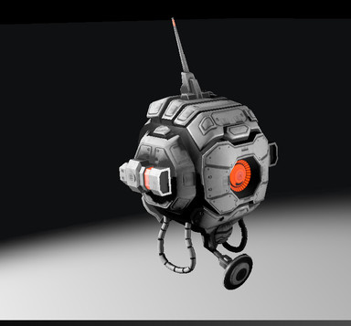
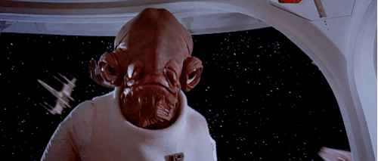
Robots
We have robot enemies!!!!
They appear and shoot laser at the player.
You get negative points if you get hit by the laser.
Notes:
Taylor

Slide 9
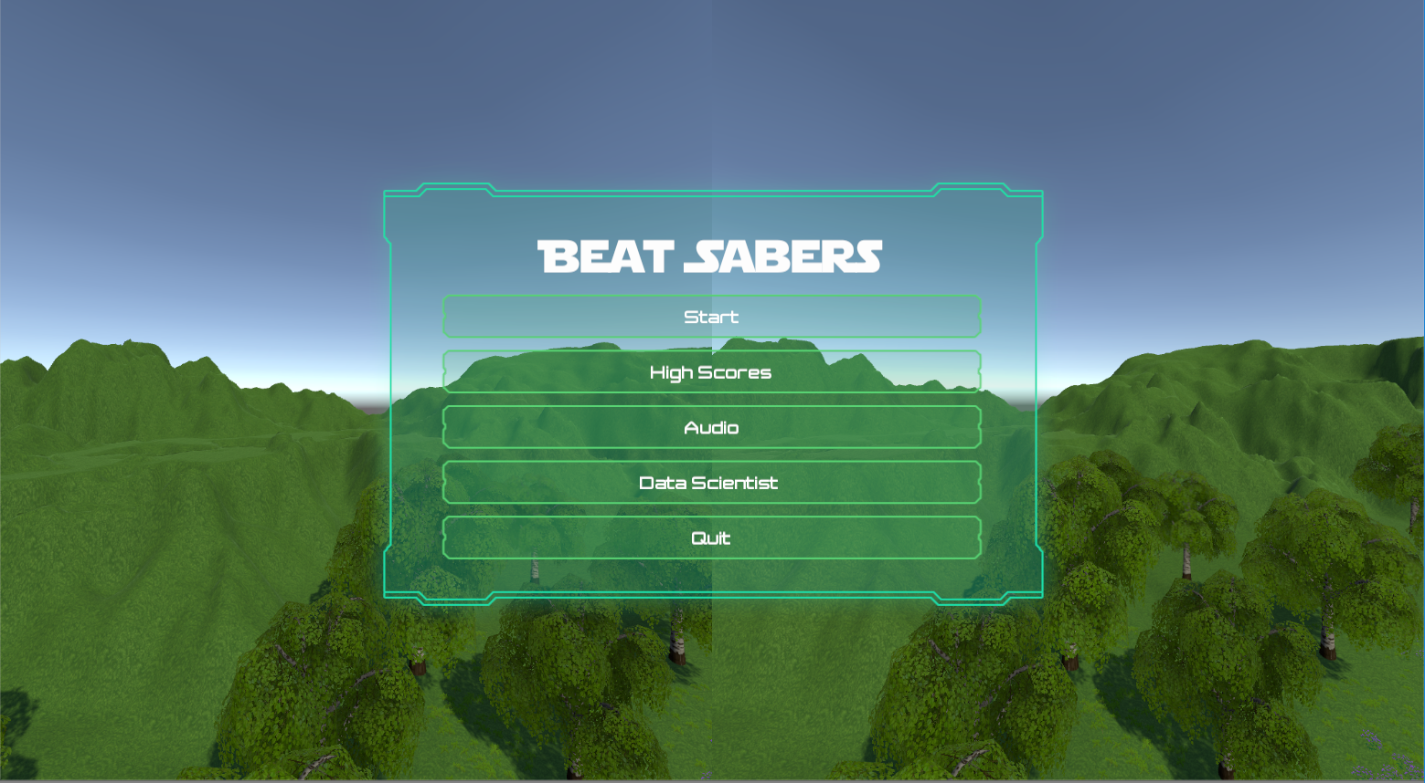
Menu
Notes:
Carmen

Slide 10

Notes:
Carmen

Slide 11
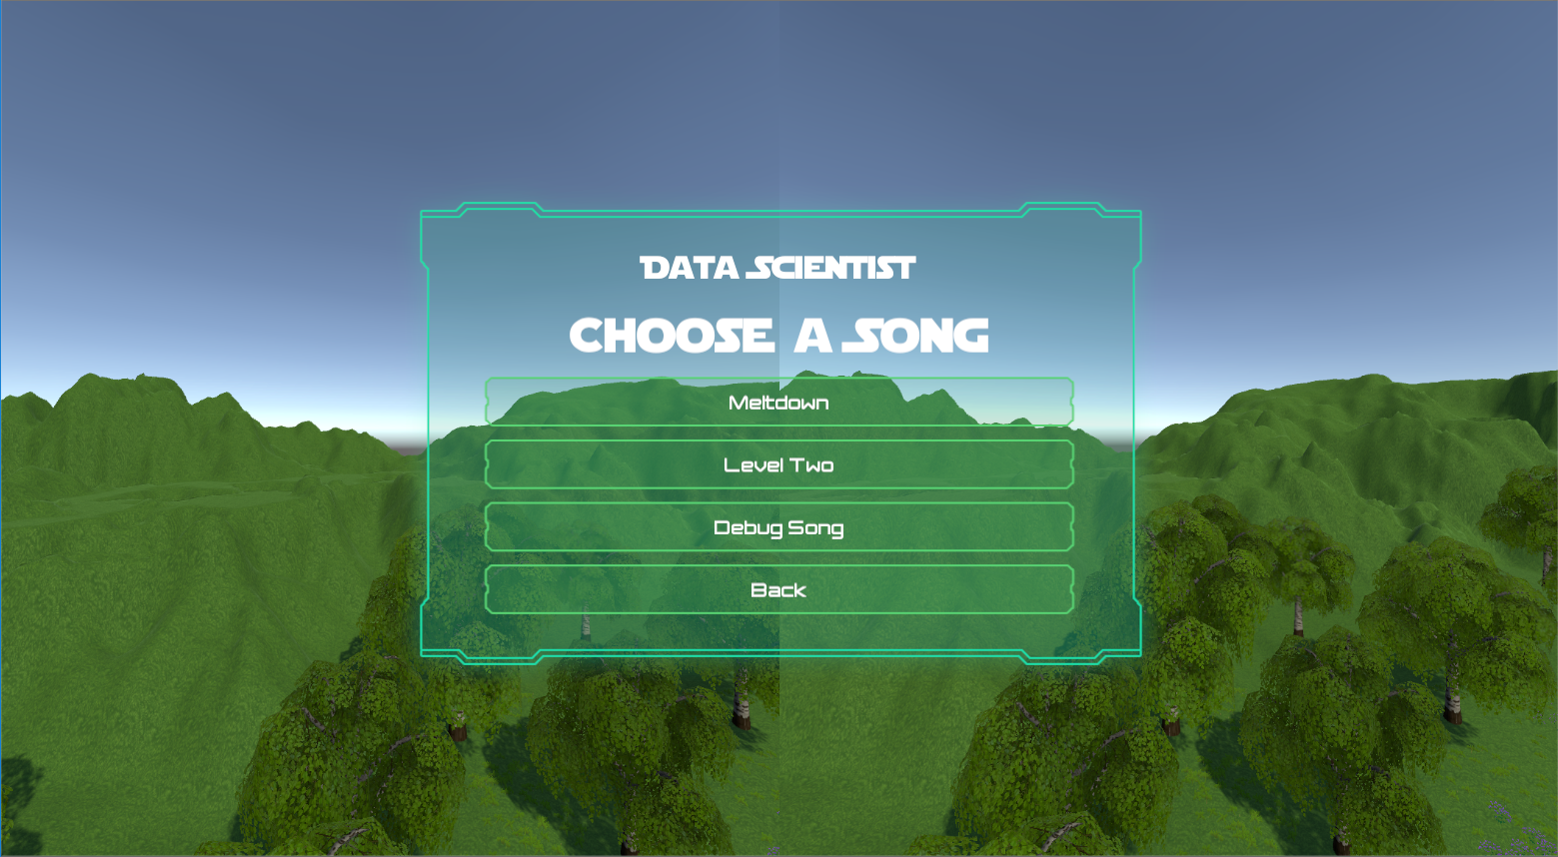
Notes:
Carmen

Slide 12
Audio
Audio Team Members:
Tools Used: AudioHelm, Ableton Live, FL Studio, FMOD
Jairus Cambe | music, midi accompaniment
Sean Thompson | sound effects
Jake Little | sound effects
James Jordan | sound effects
Notes:
Tatem and Audio Team

Slide 13
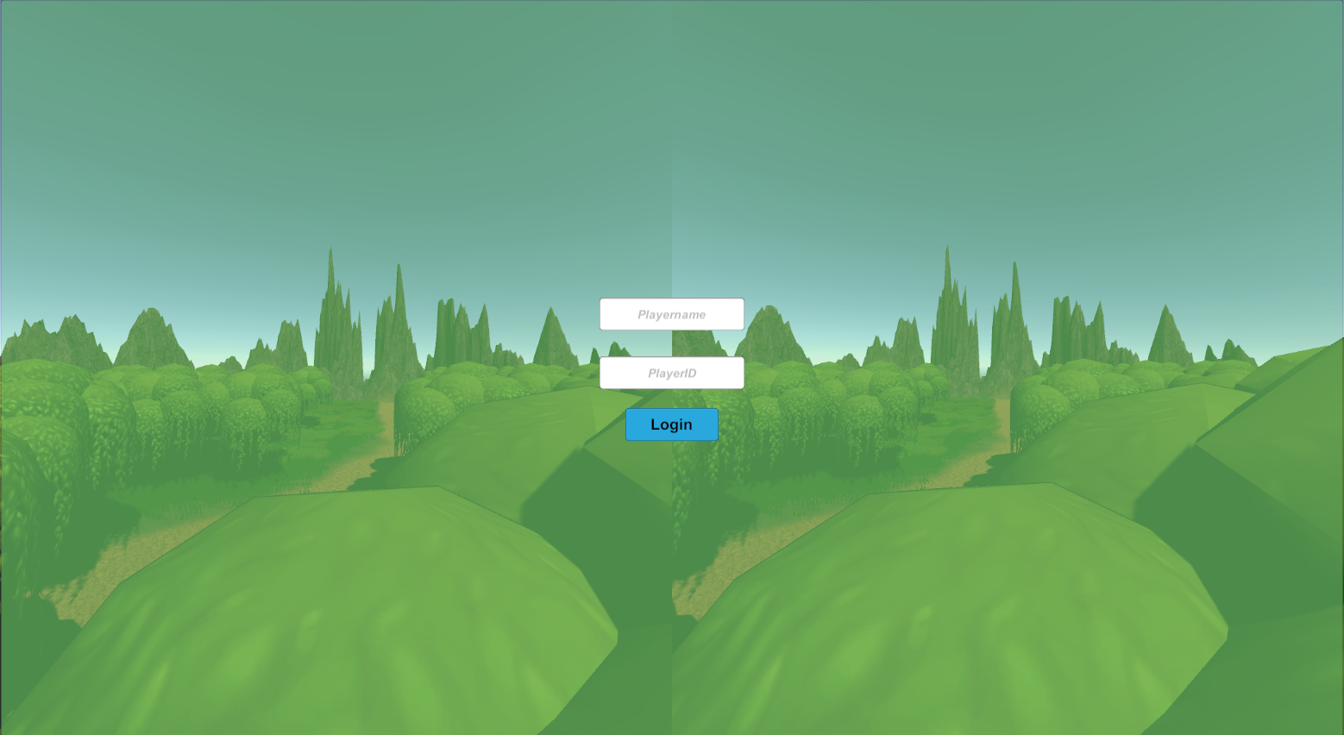
Login
Notes:
EM

Slide 14
Database
Each player’s data will store in CSV files
When scientist create the game all the data will be sent to the file’s
Notes:
EM

Slide 15
DEMO!
Space - https://www.youtube.com/watch?v=0iYTe11B0_E
Jungle - https://www.youtube.com/watch?v=0c9BNUFJsG0
Notes:
Hung

Slide 16
Obstacles
Time constraints for working with VR.
Received VR late in the semester.
Getting the scores accurately.
Scaling/distributing/co-ordinating work for large team size.
Notes:
Tatem

Slide 17
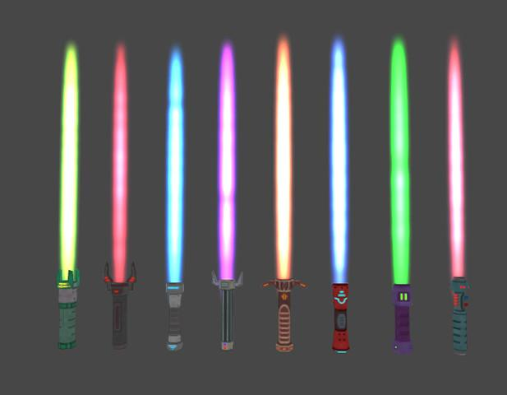
Future Goals
Adaptability
Ability to add your own songs
Scoreboard
Selection of lightsabers
Leaderboard
Notes:
Justice

Slide 18
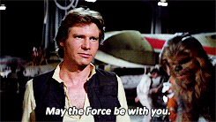
Thank You!
.

Slide 19
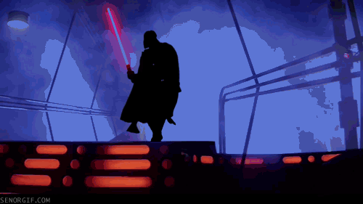

Any Question??
Notes:
Giphy.gif
Giphy.gif

